Slide 1
Scratchbuilding
(or why don’t they make a kit?)

Slide 2
By Mike Belcher
Retired Mechanical Engineer
Modelling since 1975; First kit was a scratchbuilt 1/35 tank
Resin casting since 1994; scratchbuild my own masters
Have done armour, aircraft, helicopters, sci-fi and missiles
Love building, hate painting

Slide 3
Scratchbuilding: Why do it?
Scratchbuilding: What is it?
Making a model for which there is no kit
Not available as a kit
Not available in desired scale
Existing kits are really, really awful
Desire to have something unique
Wish to be creative

Slide 4
Scratchbuilding: How to do it?
Start with a good drawing
Sorry, some math is involved
Get as much info on the subject as you can
Have a few basic tools on hand
Learn to love plastic in all its forms
Start cutting, gluing and sanding

Slide 5
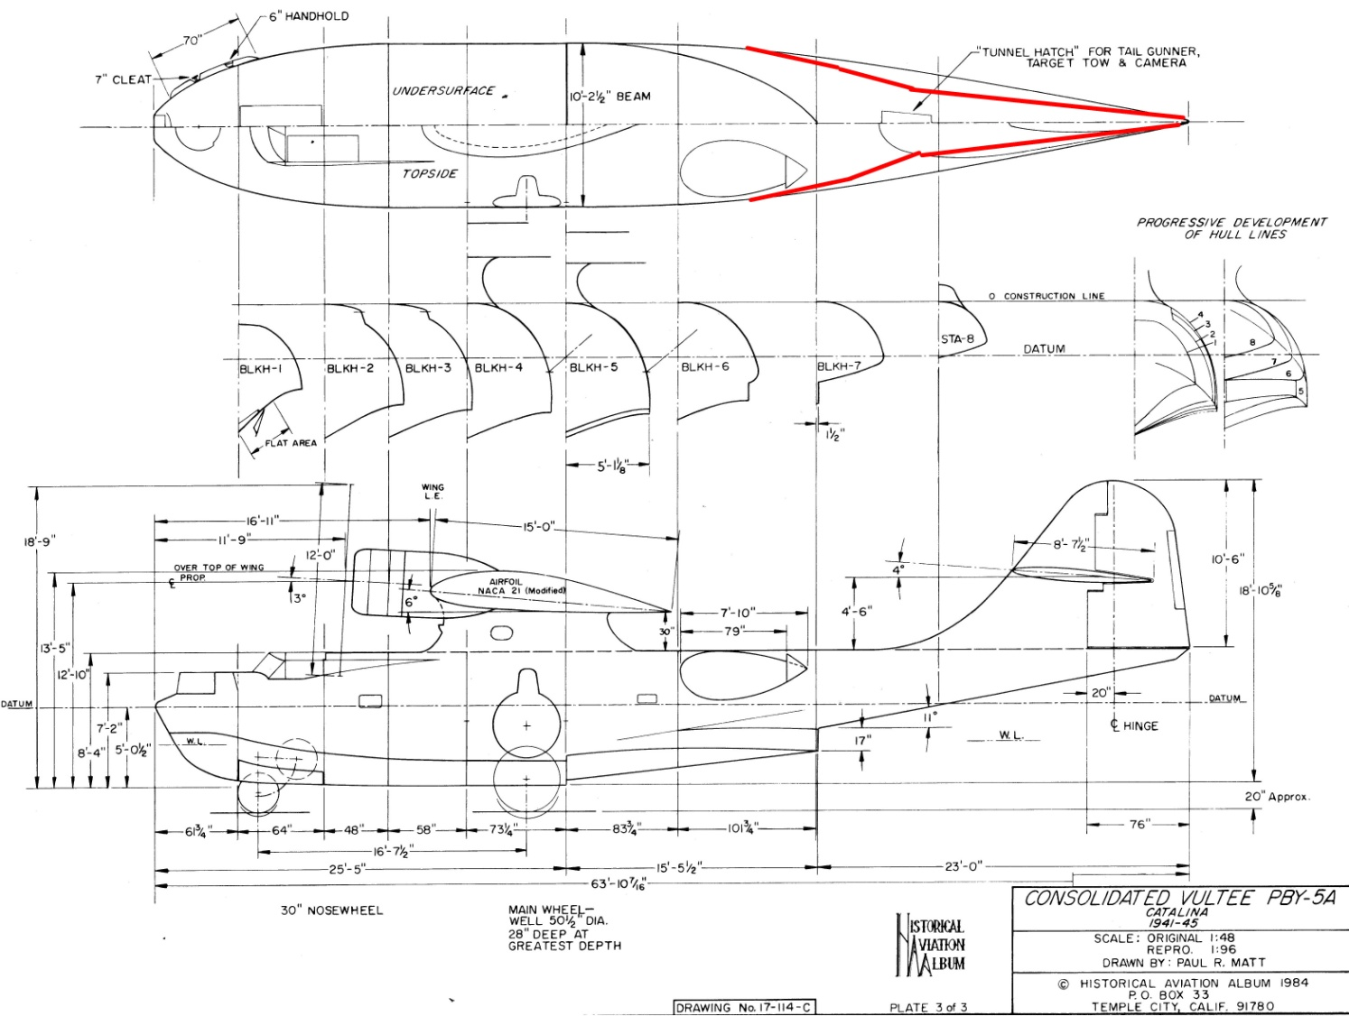
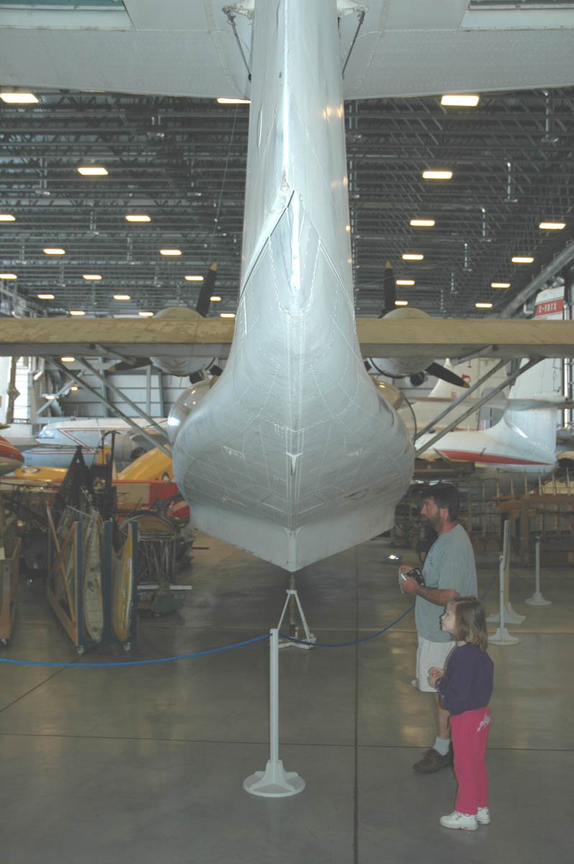
Start with a good drawing
Not all plans are accurate; Even apparently well drawn ones may contain errors

Slide 6
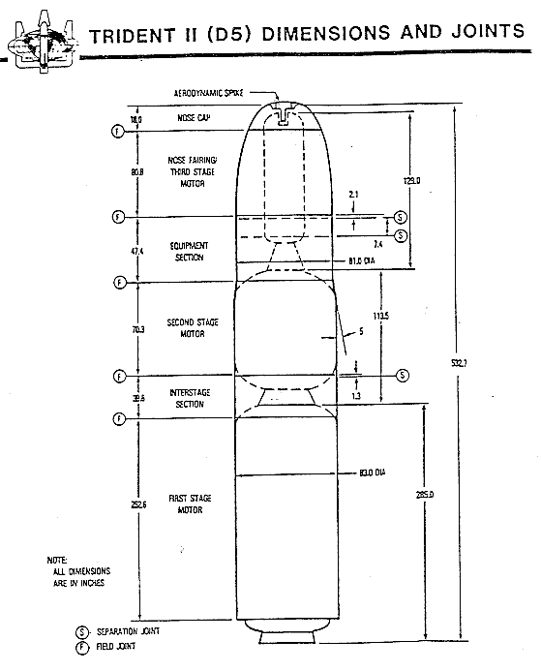
Start with a good drawing
Some plans are not even intended to be accurate, just illustrative. The hard part is knowing when!
No easy to read dimensions, but much more accurate layout
Looks OK, but not to scale.
Dimensions ARE accurate.

Slide 7
Start with a good drawing
Some plans were accurate when first drawn. However, they have been printed and re-printed and no longer match the stated scale.
Always check the drawing using dimensions.
Many drawings give a scale bar, but this is usually quite small. Better to check against a large a dimension as possible.
Some drawings give ‘Station Diagrams’. These are datum points for manufacture and are useful for accurate dimensions. However, note that in many cases, Station 0 (where all dimensions are measured from) may not be at the very front of the subject. It may even be well in front of the subject.
Typically, Station Diagrams are in inches on North American subjects, but may be in millimetres for European subjects.

Slide 8
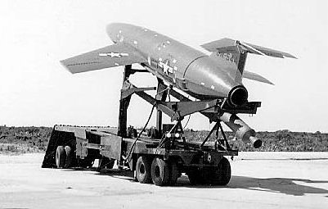
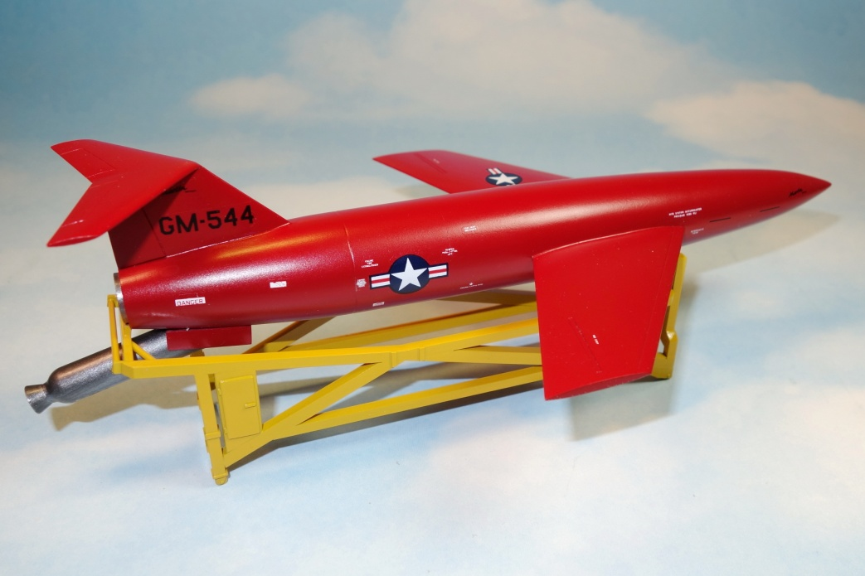
…or make a good drawing
Sometimes plans are just not available
Be careful using photos; try to get shots from the side or top
Even with straight side shots, there will be parallax distortion
You can overlap photos to try to get rid of this
Martin YB-61
All were expended as targets
None exist today
Crazy me … I wanted a model

Slide 9
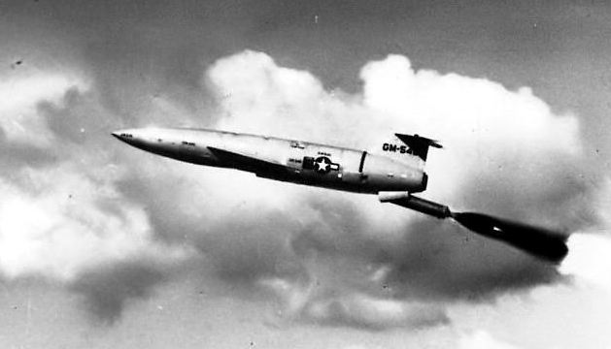
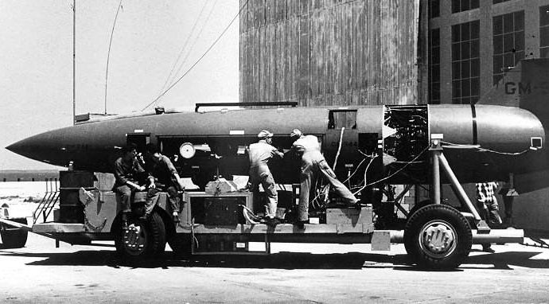
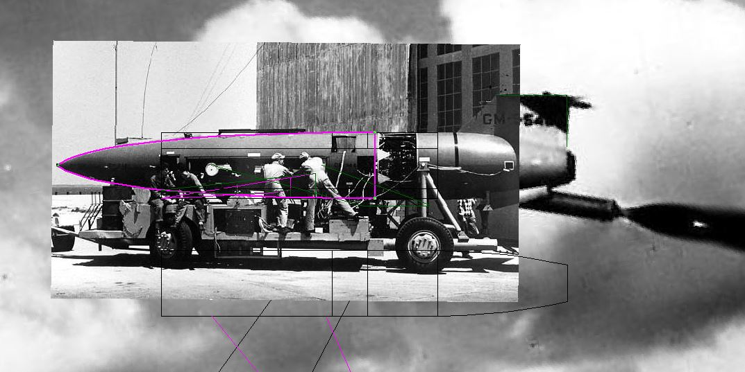
…or make a good drawing
Here I imported two side shots, scaled them and overlapped them…
…then traced my
drawing on top

Slide 10
Sorry, some math is involved
Scale: What does it mean? It is a FRACTION.
You want a 1/35 scale model of a subject. That means it is 1/35 the size of the original. If the full size object is 18 feet long, your model will 18/35 = 0.51 feet long. How long is that? Who knows! Better to work in inches (or mm).
Your 18 foot original is (18 x 12)=216 inches long. Your 1/35 model will then be 216/35 = 6.17” long.
Say you have a 1/72 drawing and you want to enlarge it to 1/48. Take the length, for example and measure it. Multiply that length by the original scale (72) to obtain the full size length. Then divide by the desired scale (48) to get the model length. This works for any scale.
The key thing to take away from this is you NEED a calculator, and you NEED a ruler marked off in decimal (10 divisions to the inch) graduations. That way, when you need to mark 6.17 inches, you can do so without having to memorize decimal equivalents to fractions.

Slide 11
Get as much info on the subject as you can
Google is your friend. Google Images is your BEST friend.
Not all websites will let you download or save images, but the snipping tool can be used to capture the image.
Gather it all together and look at what you have. Do you have views of all sides?

Slide 12
Have a few basic tools on hand
Work Surface and Layout
Rubber cutting boards are OK, but too ‘soft’.
Important to have a flat surface that you can cut and glue on; get a piece of glass.
Critical to build your basic structure as square as possible; get a small machinist square.
Handy to have a square corner to build against; get a small V block with machined faces, which is also useful to support round pieces

Slide 13
Have a few basic tools on hand
Measuring and marking
Steel rule, with decimal graduations. Get the type with machined edges and graduations right to the ends; usfeul for measuring into a corner.
Cheap plastic geometry set; sometimes you need to mark an angle with a protractor.
Circle template; useful for marking corner radii.
Digital caliper. An essential tool for all sorts of measuring.
You will need some fine point permanent ink markers or sharp soft pencils for marking cuts.
Don’t forget that calculator.

Slide 14
Have a few basic tools on hand
Cutting and scribing
Your favourite hobby knife and LOTS of replacement blades; blades should be pointed, not curved.
Steel ruler for measuring and scribing against.
Razor saw for cutting. I use larger saws rather than new-style etched blades because we are talking construction work, not detailing at this point.
‘Waldron’ style punches, but also plain paper punch

Slide 15
Have a few basic tools on hand
Gluing and Filling
Liquid cement. I use Testors because it doesn’t evaporate as quickly as some.
Cyanoacrylate glue and accelerator.
Epoxy putty. I strongly recommend Quikwood from Lee Valley Tools; much better than Milliput.
Your favourite seam filler. I use Bondo Spot putty but Tamiya is also good.
Cutex nail polish remover and Q-Tips. These will remove filler without damaging the plastic beside the seam.

Slide 16
Have a few basic tools on hand
Grinding and Filing
A small grinder can be very useful, but make sure you get variable speed. Most Dremels are much too fast and will melt plastic.
A couple good flat files. I use 4” or 6” Warding files, with a bastard cut (not single cut).
A few round files. Chain saw sharpening files come from 1/8” to 5/16” diameters.
An inexpensive set of miniature files.
A good rasp. Lee Valley Tools sells a nice one. It looks nasty, but sometimes you just need to rough out material.

Slide 17
Have a few basic tools on hand
Sanding and Finishing
Make a flat sanding board. I use a piece of aluminum about 4” x 6”, cut medium and coarse wet and dry paper to size and glue on with spray adhesive. Don’t use double sided tape as it adds flexibility and creases.
For dry sanding, I use foam backed emery boards.
For wet sanding, I make my own sanding blocks from foam sheet and wet-and-dry sandpaper, in various grits from 220 up to 1500.
A Spot Sanding Pen from Canadian Tire is great for restoring the surface finish after gluing

Slide 18
Materials: Learn to love plastic in all its forms
The basic building material: Polystyrene sheet. Available from 0.010” to 0.125”, you should have a selection. The most used will be 0.040”.
Evergreen polystyrene strip, available in a wide variety of rectangular, round and other shapes.
Brass and copper wire, available in straight lengths from hobby shops and rolls from beading stores.
Lead wire, available from outdoor stores like Bass Pro Shop. Ask for fly tying wire.
I don’t recommend carving wood. It is too soft, and difficult to finish smoothly. Mix up some Quikwood epoxy as it files well and sands very smooth.

Slide 19
Start cutting, gluing and sanding
Basic scratchbuilding is starting with a simple shape, and adding layers and details as required.
The MOST IMPORTANT STEP is to start square and build from there. Check EACH cut for squareness.
Check each cut piece dimensions. Better to cut oversize and sand/file to size than cut too small. When sanding cut edges, use the flat sanding block and check frequently.
For basic structures, use 0.040” or 0.060” sheet as material. It is much more rigid, and less likely to warp, than thinner stock.
If you need to cut two identical pieces, cut one to size, and the other oversize. Tack them together with a small drop of cyanoacrylate. Trim the oversized piece and when both are the same, slip a knife between and pop them apart. Sand the area where the glue was.

Slide 20
Keep cutting, gluing and sanding
To build a rectangular box, paint liquid glue on one edge of one piece and attach the next piece. Set them down on the glass, put the corner up against your square or V-block and make sure the joint is square. You can put a drop of cyano on the inside to hold the joint in place.
Add the corner piece and keep working, always checking the squareness.
Remember to account for thickness when you cut the pieces. That’s why the calculator is always on hand.
Be sparing in the use of liquid glue. If you need to laminate larger pieces of plastic, it is better to glue them with cyano, because flooding the surface with liquid glue will result in those pieces warping and bending as the glue dries.
Let basic boxes set overnight to fully harden. Sand the surfaces and check dimensions.

Slide 21
Keep cutting, gluing and sanding
It is always easier to add detail rather than subtract. Many detail components can be made by cutting and laminating small pieces of thin strip, cut to size
Can represent hinges with two flat pieces of strip, and a length of round strip.
Louvred hatches can be represented by using Evergreen siding.
Don’t use woven screen; it unravels and is difficult to get straight edges. Use photoetched brass or aluminum screen instead.
Non-skid surfaces are available in a number of styles as photoetched sheets.
Large bolt heads can be made from slicing hexagonal strip. It is possible to stretch strip like sprue, but for really small bolt heads, use round strip instead.
For dome-head rivets, use brass or plastic rivets for large ones, sliced round strip (lightly sanded afterwards) for medium ones and use dimensional paint for small ones.
For lines of rivets, use Archer or Micromark rivet decals.
For weld beads, use stretched sprue (painted with liquid glue and textured) or Archer decals.

Slide 22
Keep cutting, gluing and sanding
I like Testors liquid glue for most construction. Tamiya Extra Thin is also good.
If you are gluing ABS or other types of plastic than polystyrene, you will need to use a ‘hotter’ adhesive like Tenax or MBS solvent.
Cyanoacrylates are indispensable but difficult to use sparingly. I will try to tack the thing in place with regular glue, then using a needle or special cyano applicator, just allow a drop to run around the object to hold it in place. Carefully remove the excess cyano immediately, and give it a quick spray with accelerator. Note that the accelerator remains on the surface until washed off, so your next drop of cyano may just bead on the surface if it has not been cleaned.
Epoxy putties are great for building up non-rectalinear shapes. I use Quikwood from Lee Valley Tools exclusively. Peel back the covering, use a sharp knife to cut a thin sliver off the open end, cut a small length and fold and roll. When you think it’s well mixed, fold and roll some more. Press it into place and form it roughly into place. Use a wet finger to smooth it in place. With practice, you can get so you need very little filing and sanding afterwards. It files well but will clog up the file so the key is to use a rasp to roughly shape it, and sandpaper to do final finish. You can add more putty later if needed.

Slide 23
Keep cutting, gluing and sanding
Use a combination of scribing and sprue for a number of effects.
For raised ribs on metal fenders: Scribe the cressed pattern in the base plastic, glue round strip in the scribed slots, fill gaps with putty and use Cutex to rub away excess putty everywhere but alongside the strip. You don’t want to sand because you don’t want to flatten the strip.
For fabric areas on aircraft: Scribe the stringer pattern, glue round strip in the scribed slots, use your fingertip to smear putty between the stringers. You can sand these afterwards but use a rounded sanding block. You want to end up with a subtle scalloped efect.
Don’t try to reproduce the fabric texture for aircraft. On doped aircraft, the surface is a smooth as metal.
When done detailing, give the area a coat of Tamiya primer. It is an excellent primer straight from the can. However, small items will not adhere as well to a primed surface as to bare plastic, so wait until you are completed to prime the model.

